Slide 1


Specialization
.Net 4.5.2, CLR Internals
C# 6.0, WPF 4.5 .2 with Blend
ASP.Net 5,0, ASP.Net MVC 6.0
Linq 4 & ADO.Net EF 7.0
WCF 4.5.1, Web API, WF 4.5.1
Prism 5 with MEF & MVVM
Cloud Computing (Azure)
UML 2 and OOAD
HTML 5, CSS 3, SASS
65 .Net Design Patterns
JavaScript, Jquery 2.x , Bootstrap
Type Script, Angular 2.0,
ES 6, Immutable JS, React, Flux, Redux
Ext JS 6.0 , Ember , Backbone
Kendo UI, D3.js, Polymer js
Node.js, Dust.js, Jade ,Mongo
hapi.js, system.js, Phantom.js
Mocha, QUnit, Jasmine,karma
Webpack,Grunt,Gulp, youman
REACT JS with Redux
D.S.R.Murthy M.Tech (IT)
Software Architect & Corporate Trainer
Experience : 25 years

Slide 2

Ajenda
Introduction
What is React.js?
Virtual DOM (Compare with angular)
Installing react with Babel,webpack
React Boilerplate
Hello World Application
Debugging React with React-dev-tool
JSX
What is JSX? (DSL)
Complete JSX API
Using React with JSX
Using React without JSX
Plugins
Components
State Machines (props vs states)
Component Life-Cycle
Dynamic components, Mixins, Forms
Events (synthetic events)
Compositions
Communication Between Components
ReactLink - Two-Way Data Binding
Validating forms in React
React with REST using Jquery Ajax
Routing in React
Animation in React
Backbone vs Angular vs React
React with Firebase
SPA with React (Blog case study)
React with Webpack, Gulp
Introduction to FLUX with React (Case study)
https://facebook.github.io/react/docs/getting-started.html

Slide 3

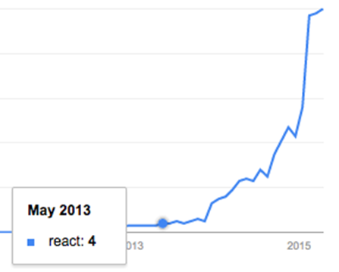
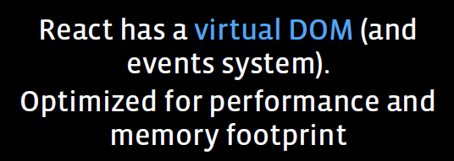
Introduction
React Goal :
Building large applications with data
that changes over time.

Slide 4
Virtual DOM Diff calculation (Inexpensive)
React uses virtual DOM to keep track of what has changed in the real DOM. (Fast and Minimal DOM updates)
React always keeps a copy of the representation of the actual DOM in memory.
Whenever something changes, such as some state manipulation, it calculates another copy of the DOM that will be generated with new state and props.
Then it calculates the difference between the original copy of the virtual DOM and the new copy of the virtual DOM.
This difference results in minimal operations on the real DOM that can take the current DOM to a new stage.

Slide 5
Introduction
Born in the year 2003.
React is a UI library developed at Facebook to facilitate the creation of interactive, stateful & reusable UI components. (Component Driven Development)
It is V in MVC
It is used at Facebook and Instagram.com is written entirely in React.
Works both client and server side (Isomorphic JS)
React Goal :
Building large applications with data
that changes over time.

Slide 6
Who is using React?
Facebook
Instagram
Netflix
Alibaba
Yahoo
E-Bay
Khan-Academy
AirBnB
Sony
Atlassian

Slide 7
Why React ?
Simple
React will automatically manage all UI updates when underlying data changes.
Declarative
When the data changes, React conceptually hits the "refresh" button, and knows to only update the changed parts.
Build Composable Components (DRY) & Testable
React is all about building reusable components with encapsulation to make code reusable, testable (jest) and makes separation of concern.

Slide 8
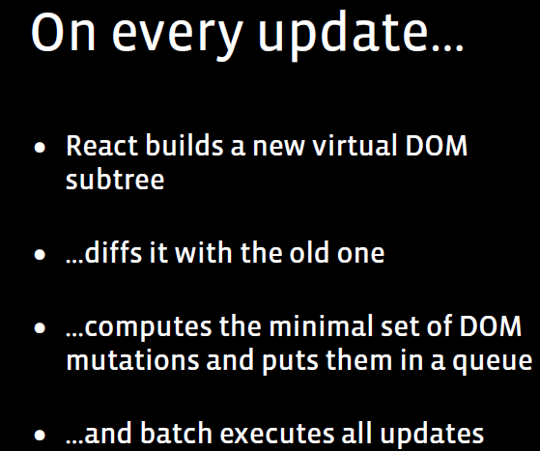
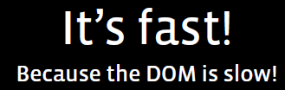

Introduction- React

Slide 9
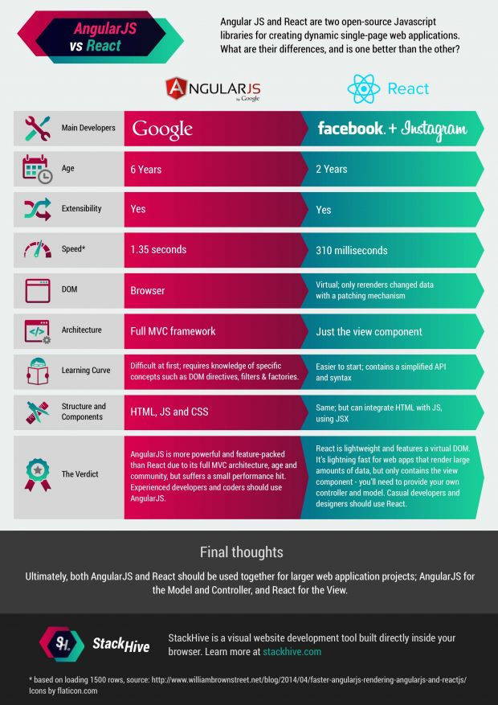
Angular vs React

Slide 10
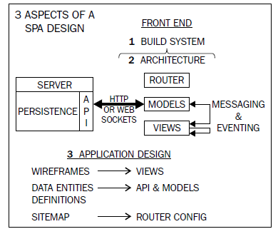
SPA architecture

Slide 11
About React JS
It is a popular client-side library/framework for building user interfaces, which is developed and used by Facebook.
React for organizing application around discrete components, with each handling its own rendering and state. Components can be nested within each other.
React is fast because it minimizes the number of writes to the DOM
The recommended way to write React code is by using JSX – an extension to JavaScript which presents components as HTML elements.
JSX needs to be compiled to JS in order to work in browsers.

Slide 12
How React works?
For Change detection:
(1) React uses an observer model instead of dirty checking (continuous model checking for changes).
That’s why it doesn't have to calculate what is changed, it knows immediately.
It reduces the calculations and make the app smoother. But the really cool idea here is how it manages the DOM manipulations:

Slide 13
How React works?
For the DOM changing challenge
(2) React builds the tree representation of the DOM in the memory and calculates which DOM element should change.
DOM manipulation is heavy, and we would like to keep it at the minimum
React tries to keep as much DOM elements untouched as possible.
Given the less DOM manipulation can be calculated faster based on the object representation, the costs of the DOM changes are reduced nicely.

Slide 14
React Component
The Component is the primary building block in React.
The Component maintains an immutable property bag called props, and a state that represents the user-driven state of the UI.
Instead of constructing a physical DOM directly from a template file/script/function, the Component generates an intermediate DOM that is a stand-in for the real HTML DOM.

Slide 15
React Component
An additional step is then taken to translate this intermediate DOM into the real HTML DOM.
As part of the intermediate DOM generation, the Component also attaches event-handlers and binds the data contained in props and state.
The intermediate-DOM is just a JavaScript object graph and is not rendered directly.
The translation step that creates the real DOM that makes React do fast DOM manipulations.

Slide 16
React Component
compose the UI of application by assembling a tree of Components.
Each Component provides an implementation for the render() method, where it creates the intermediate-DOM.
Calling React.renderComponent() on the root Component results in recursively going down the Component-tree and building up the intermediate-DOM.
The intermediate-DOM is then converted into the real HTML DOM.

Slide 17
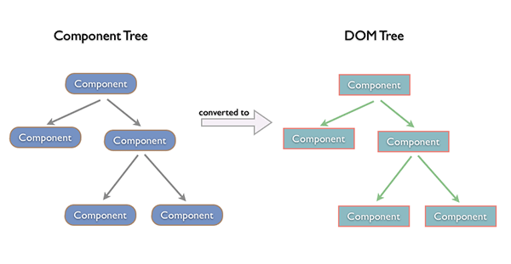
How React Works

Slide 18
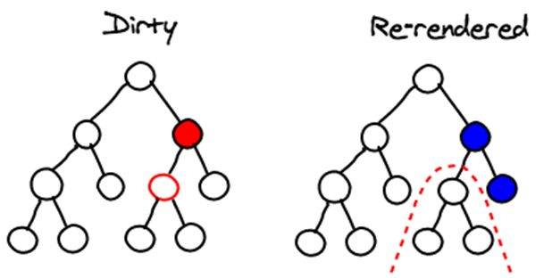
How React Works
React applies changes by running a “diffing” algorithm, which identifies what has changed.
The second step is “reconciliation”, where it updates the DOM with the results of diff.

Slide 19
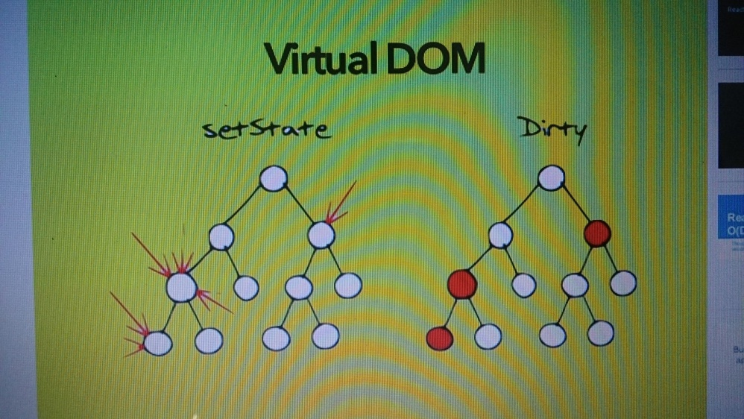
React Algorithm
The Virtual DOM
Pure render function:
f(d)=v (take data and render)
f(d’)=v’ (Data changes) - Delta
diff(v,v’)= changes (apply diff algorithm to apply DOM update where required)

Slide 20
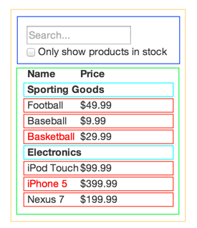
Component Driven Development – Data Flow
FilterableProductTable
SearchBar
ProductTable
ProductCategoryRow
Single Responsibility Principle
Design components to be responsible for only one thing.

Slide 21
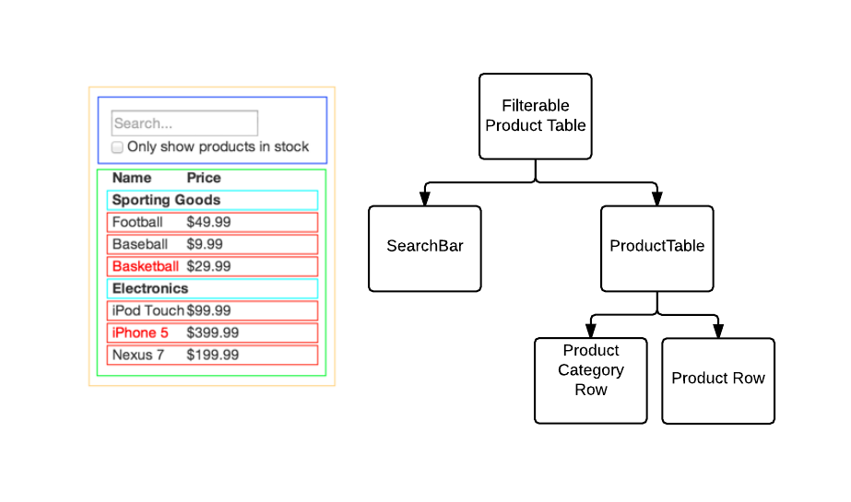
Top down rendering - FLUX

Slide 22
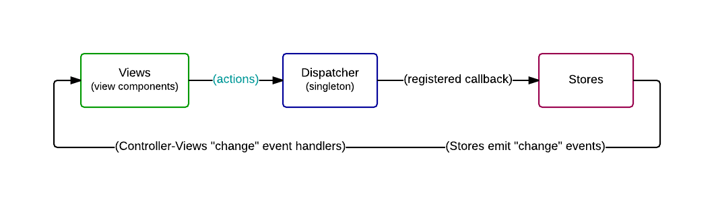
FLUX
FLUX

Slide 23
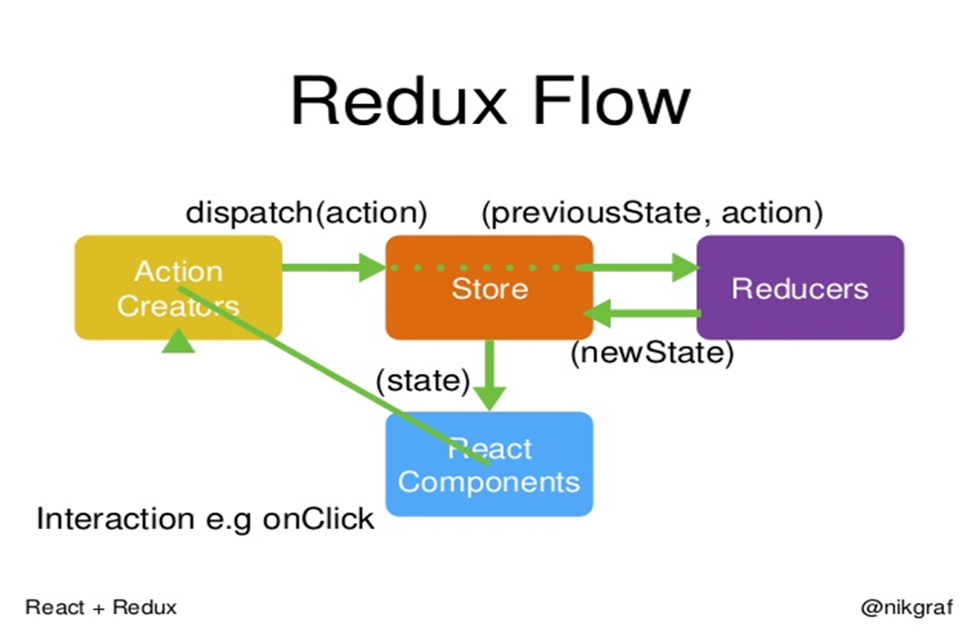
Redux

Slide 24
Editors for React JS
Sublime Text 3.0 with Babel plugin
Eclipse
Visual Studio 2013
Jet Brains
JS Fiddle

Slide 25
Build tools / Bundlers with HMRE
Webpack
Grunt
Gulp
Asp.Net MVC 5 with Visual Studio 2013

Slide 26
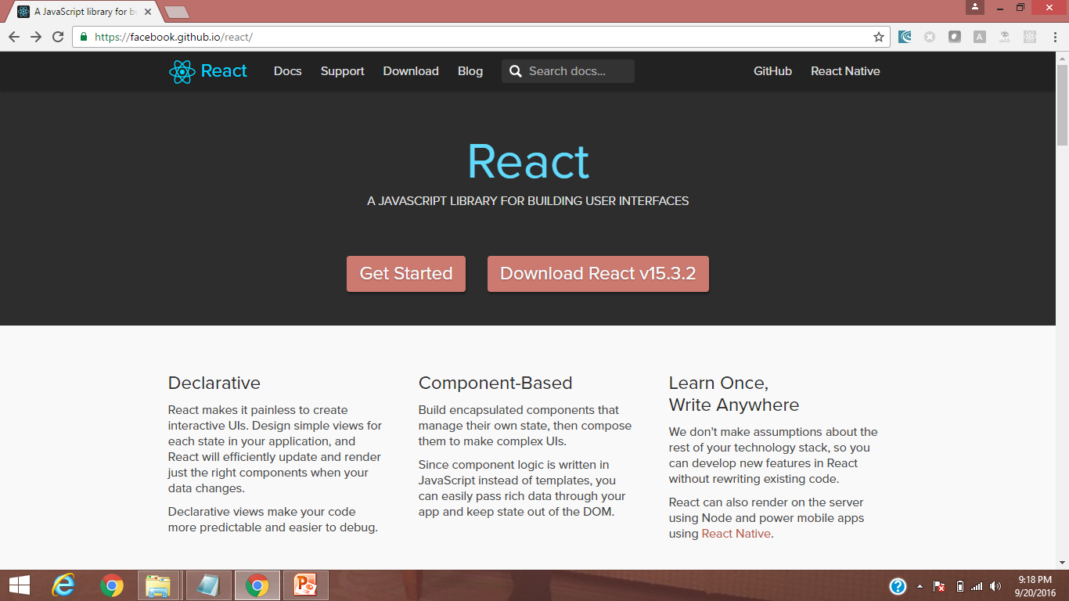
Setup React
http://facebook.github.io/react/

Slide 27
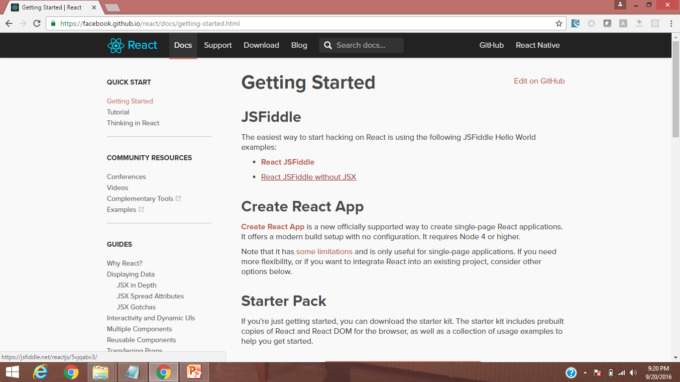
Setup React

Slide 28
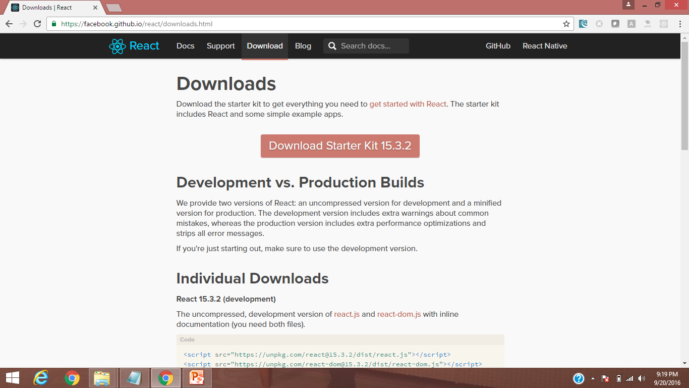
Setup React

Slide 29
First App in React JS without JSX
<!DOCTYPE html>
<html>
<head>
<title>First React app</title>
<script src="https://fb.me/react-15.0.2.min.js">
</script>
<script
src="https://fb.me/react-dom-15.0.2.min.js">
</script>
</head>
<body>
<div id="container"></div>

Slide 30
First App in React JS without JSX
<script>
var App = React.createClass({ // React Component
render: function(){
return(
// null means we are not passing any attributes
React.createElement(
"h1", null,"Welcome to React , Murthy!"));
}
});
// mountpoint / mountnode / rootnode
ReactDOM.render(React.createElement(App),
document.getElementById("container"));
</script>
</body>
</html>

Slide 31
First App in React JS with JSX
<script>
var App = React.createClass({
render: function(){
return <h1>
Hello fro React , Murthy!
</h1>;
}
// mountpoint / mountnode / rootnode
ReactDOM.render(<App/>,
document.getElementById("container"));
</script>
</body>
</html>

Slide 32
JSX – JavaScript and XML
JSX is a XML-like syntax extension to ECMAScript.
React provides a convenient XML-based extension to JavaScript, called JSX, to build the component tree as a set of XML nodes.
JSX simplifies the association of event-handlers and properties as xml attributes.
A JSX XML node maps directly to a Component.
Because JSX is not supported in browsers by default we have to compile it to JS.
(Babel can transpile JSX to JS).

Slide 33
JSX – JavaScript and XML (HTMLish)
JSX to create JavaScript objects using XML syntax. To generate a link in React using pure JavaScript :
// JSX version
React.render(
<div>
<h1>Header</h1>
</div>
);
// This would translate to
React.render(
React.createElement('div', null,
React.createElement('h1', null, 'Header')
); );

Slide 34

Setup React – Directly work with jsfiddle.net
Babel is a JavaScript compiler will compile JSX to JavaScript.
https://jsfiddle.net/
HTML5
<script src="https://fb.me/react-with-addons-0.14.0.js"></script>
<script src="https://fb.me/react-dom-0.14.0.js"></script>
<div id="view"/>
Babel
var HelloReact = React.createClass({
render: function() {
return <h1>Hello React</h1>
}
});
ReactDOM.render(<HelloReact />, document.getElementById('view'));
Hello React

Slide 35
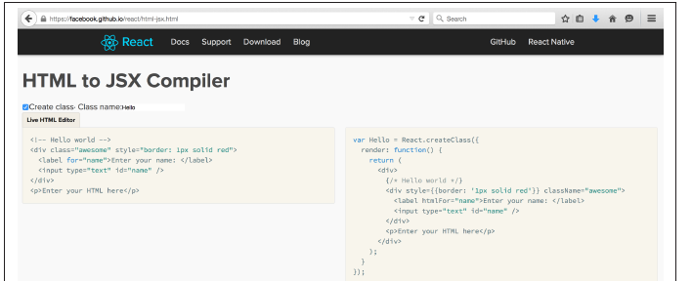
HTML to JSX
Use below link for transitioning an app’s markup from HTML: an HTML-to-JSX transformer
https://facebook.github.io/react/html-jsx.html)

Slide 36
Setup React - Babel
Decompiling JSX
Babel has created a tool that allows seeing the decompiled JavaScript that would be created during JSX transformation.
The Babel tool is shown in the following screenshot, and you can find the tool at https://babeljs.io/repl/:

Slide 37
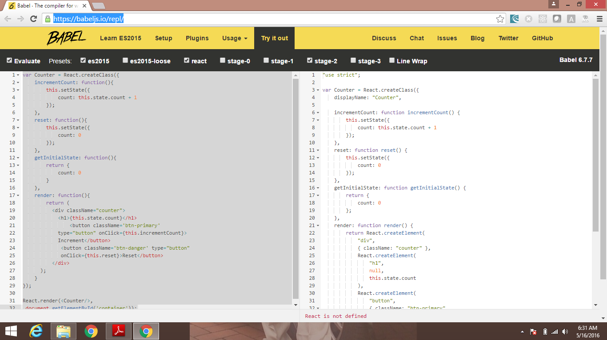
Setup React - Babel

